Slide 1
Micro Credit Loan
Defaulter prediction model

Slide 2
Problem Statement
Telecom Service Provider
Provides Micro-Credit on Mobile Balances
To Low-income families
Payback in 5 days
==>
Non-Defaulter
Do not Payback
==>
Defaulter

Slide 3
Our Task
customers mobile usage & micro-credit loan patterns.
Non-Defaulter
Defaulter
Given certain details about customers such as mobile network usage patterns and mobile balance loan history, we are required to build a model that predicts whether a customer will pay the loan within 5 days or not.

Slide 4
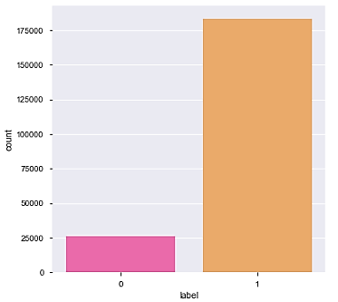
EDA Visualizations
Univariate Analysis with Target Distribution
This countplot from seaborn reveals imbalance in data between the Defaulter class (0) and the Non-defaulter (1) class.

Slide 5
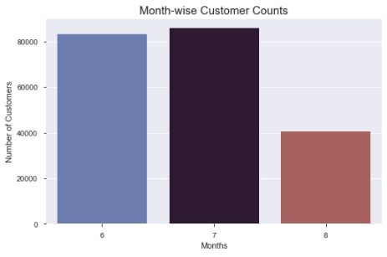
EDA Visualizations
Bi-variate analysis with Month-wise Customers
In this plot, more customer footprint is observed in the months of July and June as compared to August. This likely indicates a monthly trend where more users would need credit.

Slide 6
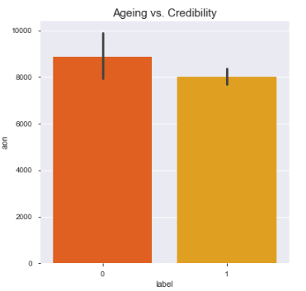
EDA Visualizations
Bi-variate analysis with Age on Network and Loan status
This graph attempts to plot a relation between customer age on network and their likelihood for defaults. The more the time a customer has spent on the same network, lesser is the chance of a default. Our client can give more preference to loyal customers for giving out credit.

Slide 7
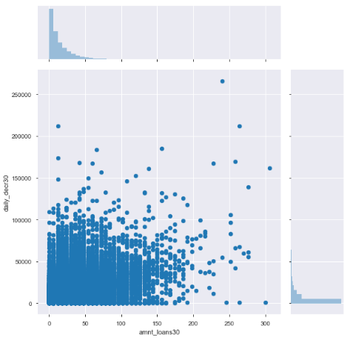
EDA Visualizations
Bivariate Analysis with Total loan amount and Daily balance used
Here, we can see a faint linear relationship between the two.
.

Slide 8
EDA Steps
Outliers
Identified using boxplots.
Skewness
Treated using power transform function in yeo-johnson method.
Scaling
Values were scaled down to 0 to 1 range using standard scaler.
Removed using z-scores.
Data Imbalance
SMOTE oversampling technique was used to remove the imbalance in label.

Slide 9
Building Models
Train Test Split
First, we split the data into train and test sets.
Test Multiple Models
Next, we fit various models such as Logistic Regression, Random Forest, KNN, Decision Tree, XGBoost, Gradient Boosting, etc
Hyper Parameter Tuning
We set a parameter criterion.
Using Randomised Search CV, find the best parameters that give best performance.

Slide 10
Model Dashboard
Algorithms Tested | Key Metrics of the Hyper Parameter Tuned Model
 | Accuracy Score | Precision (0 | 1) | Recall (0 | 1) | F1 score (0 | 1)
Logistic Regression | 0.7807 | 0.78 | 0.79 | 0.79 | 0.77 | 0.78 | 0.78
Random Forest Classifier | 0.7811 | 0.78 | 0.78 | 0.79 | 0.78 | 0.78 | 0.78
Decision Tree Classifier | 0.8454 | 0.86 | 0.83 | 0.82 | 0.87 | 0.84 | 0.85
K Neighbors Classifier | 0.9372 | 0.89 | 0.99 | 0.99 | 0.88 | 0.94 | 0.93
Gradient Boosting Classifier | 0.9465 | 0.96 | 0.94 | 0.94 | 0.96 | 0.95 | 0.95
XGB Classifier | 0.9490 | 0.96 | 0.94 | 0.94 | 0.96 | 0.95 | 0.95

Slide 11
Final Model
Model
Accuracy
94.90%
Hyper Parameter Tuning
with Randomised Search CV
Best Params- {'reg_lambda': 10, 'reg_alpha': 0, 'n_estimators': 100, 'max_depth': 15, 'learning_rate': 0.7, 'gamma': 0.001}
XGB Classifier Model
Accuracy- 94.78%

Slide 12
Conclusion
To improve customer selection for micro-credit, this prediction model can be used effectively.
However, as data scientists our task is to not just solve problems but also come up with innovative solutions to mitigate issues further.
By lending to only those customers who will not default, we are limiting the target consumer base.
If instead, we introduce enticing schemes that reward early credit repayments, we can successfully convert even the current defaulters.
This will result in a win-win situation for both service provider whose defaults will reduce, as well as low-income customers who will get unrestricted access to micro-credit on mobile balances.

